Slide 1

ROM chips
Computer Organization and Architecture | Memory & I/O Organization
Course: Computer Organization and Architecture | Chapter: Memory & I/O Organization | Program: Bachelor of Engineering
DISCOVER · LEARN · EMPOWER
Notes:
Welcome everyone to today's lecture on ROM chips within our Memory and I/O Organization chapter. As we explore this topic, remember that Read-Only Memory is the foundation of system booting. We will analyze how these non-volatile chips store critical firmware that your computer needs to start up every time.

Slide 2
Course Outcomes
SLIDE 2 / 10
Course Outcome
CO | BT LEVEL | DESCRIPTION
CO1 | BT3 | Apply number systems and digital logic to design basic digital circuits
CO2 | BT4 | Analyze register organization and instruction set architecture
CO3 | BT3 | Implement computer arithmetic algorithms and floating-point operations
CO4 | BT5 | Analyze memory hierarchy and input-output organization
CO5 | BT6 | Evaluate control unit design and pipelining performance
Chandigarh University
2 / 10
Notes:
Today's lecture directly addresses Course Outcome 4, which requires you to analyze memory hierarchy and input-output organization. We will focus specifically on how ROM fits into the broader memory hierarchy as a non-volatile storage layer. Understanding ROM is essential for analyzing how the system initializes and manages input-output operations during the boot process.

Slide 3
Learning Objectives
SLIDE 3 / 10
Learning Outcomes
1
Evaluate the fundamental differences between ROM and RAM in system architecture.
2
Classify various types of ROM chips including PROM, EPROM, and EEPROM.
3
Analyze the internal structure and addressing mechanisms of ROM chips.
4
Assess the role of ROM in the system boot sequence and firmware storage.
5
Compare the performance characteristics of different ROM technologies in modern systems.
Chandigarh University
3 / 10
Notes:
By the end of this session, you will be able to evaluate the fundamental differences between ROM and RAM in system architecture. We will classify various types of ROM chips including PROM, EPROM, and EEPROM to understand their evolution. You will also analyze the internal structure and addressing mechanisms of ROM chips to see how data is retrieved.

Slide 4
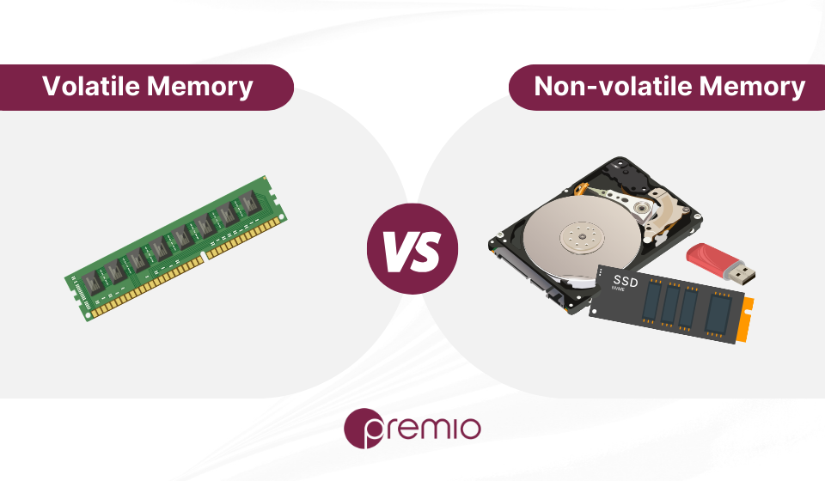
Lecture
SLIDE 4 / 10
Definition and Core Characteristics
1
ROM is non-volatile memory that retains data without power supply.
2
Data is permanently stored during manufacturing or via specialized programming.
3
ROM provides read-only access preventing accidental modification of critical data.
4
It serves as the primary storage for system firmware and boot instructions.
5
Access time is typically faster than sequential storage like hard drives.
Volatile vs Nonvolatile Memory: What's the Main Difference? – Premio Inc
Chandigarh University
4 / 10
Notes:
ROM is non-volatile memory that retains data without power supply, unlike RAM which loses data when turned off. Data is permanently stored during manufacturing or via specialized programming, making it ideal for critical system instructions. ROM provides read-only access preventing accidental modification of critical data, ensuring the system remains stable. It serves as the primary storage for system firmware and boot instructions, acting as the bridge between hardware and software.

Slide 5
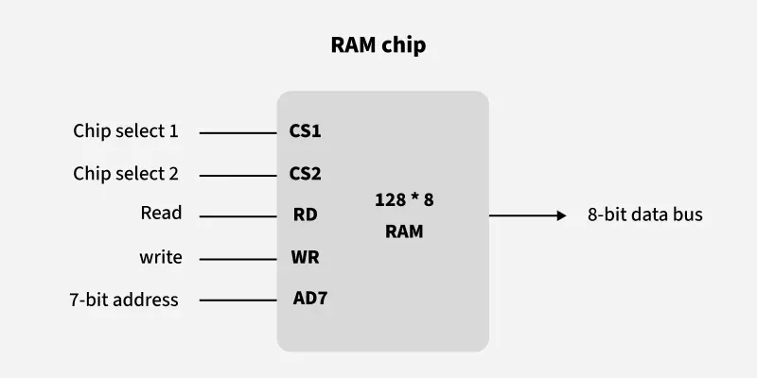
Types of ROM
SLIDE 5 / 10
PROM and EPROM
1
PROM is programmed once by the user using a high-voltage pulse.
2
EPROM uses ultraviolet light to erase data for reprogramming capabilities.
3
EPROM chips feature a quartz window to allow UV light exposure.
4
PROM is suitable for low-volume production where flexibility is needed.
5
EPROM allows multiple erasure cycles but requires physical removal for updates.
Different Types of RAM (Random Access Memory ) - GeeksforGeeks (source: media.geeksforgeeks.org)
Chandigarh University
5 / 10
Notes:
PROM is programmed once by the user using a high-voltage pulse, offering flexibility after manufacturing. EPROM uses ultraviolet light to erase data for reprogramming capabilities, allowing for updates in the field. EPROM chips feature a quartz window to allow UV light exposure, which is a distinctive physical characteristic. PROM is suitable for low-volume production where flexibility is needed, while EPROM allows multiple erasure cycles but requires physical removal for updates.

Slide 6
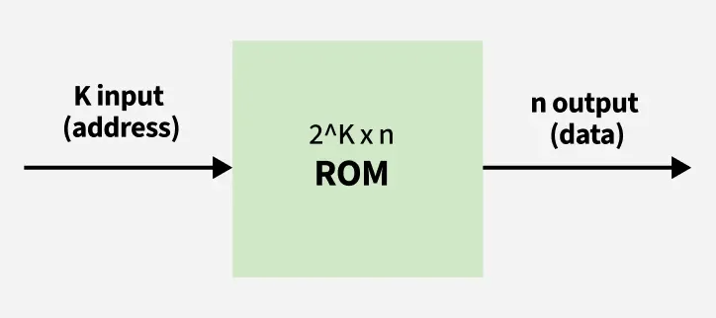
Types of ROM
SLIDE 6 / 10
EEPROM and Flash
1
EEPROM allows byte-level electrical erasure without removing the chip.
2
Flash memory is a specialized EEPROM optimized for block-level operations.
3
Flash memory offers faster write speeds and higher density than EEPROM.
4
Modern BIOS and UEFI firmware are typically stored in Flash memory.
5
EEPROM is used for storing configuration settings that change infrequently.
Read Only Memory (ROM) - GeeksforGeeks (source: media.geeksforgeeks.org)
Chandigarh University
6 / 10
Notes:
EEPROM allows byte-level electrical erasure without removing the chip, providing great flexibility for small data changes. Flash memory is a specialized EEPROM optimized for block-level operations, making it ideal for large storage needs. Flash memory offers faster write speeds and higher density than EEPROM, which is why it dominates modern storage. Modern BIOS and UEFI firmware are typically stored in Flash memory, ensuring reliable and updatable system initialization.

Slide 7
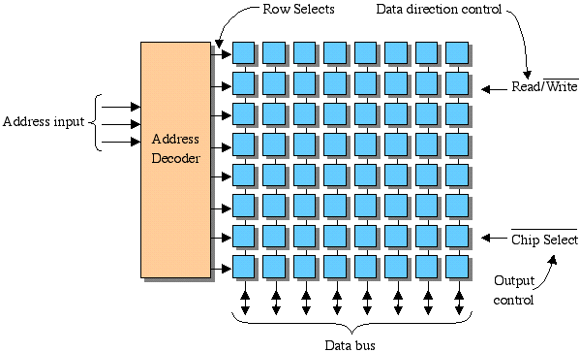
Lecture
SLIDE 7 / 10
Internal Structure and Addressing
1
ROM uses a decoder to select specific memory cells based on address lines.
2
The address bus width determines the total number of addressable memory locations.
3
Data is stored in a matrix of cells connected to bit lines.
4
Read operations activate the selected row and column to output data.
5
ROM does not require refresh circuits unlike dynamic RAM technologies.
Source: faculty.etsu.edu
Chandigarh University
7 / 10
Notes:
ROM uses a decoder to select specific memory cells based on address lines, ensuring precise data retrieval. The address bus width determines the total number of addressable memory locations, defining the chip's capacity. Data is stored in a matrix of cells connected to bit lines, forming the core storage structure. Read operations activate the selected row and column to output data, while ROM does not require refresh circuits unlike dynamic RAM technologies.

Slide 8
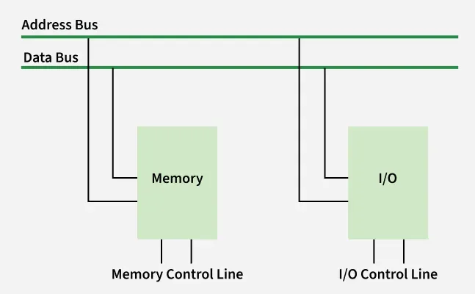
Worked Example
SLIDE 8 / 10
Addressing Calculation
GOVERNING EQUATION
A ROM chip with 12 address lines can address 2¹² = 4096 locations
1
If each location stores 8 bits, total capacity is 4096 × 8 = 32 Kbits.
2
Address range spans from 0000h to 0FFFh in hexadecimal notation.
3
Selecting address 0x0500 activates the 1281st memory cell in the array.
4
Total capacity in bytes is calculated as 2^address_lines × data_width.
Source: media.geeksforgeeks.org
Chandigarh University
8 / 10
Notes:
Let's look at a concrete example: A ROM chip with 12 address lines can address 2¹² = 4096 locations. If each location stores 8 bits, total capacity is 4096 × 8 = 32 Kbits, which is a standard size. Address range spans from 0000h to 0FFFh in hexadecimal notation, making it easy to reference in code. Selecting address 0x0500 activates the 1281st memory cell in the array, demonstrating how linear addressing works in practice.

Slide 9
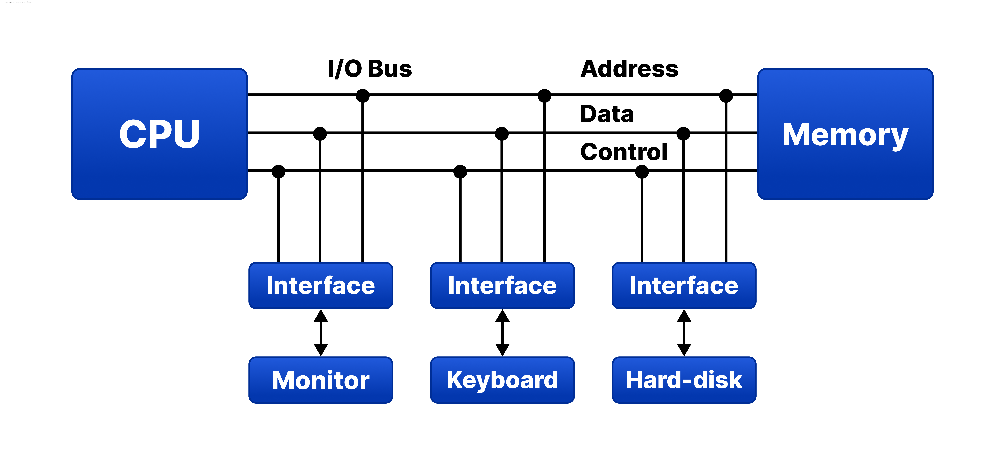
Lecture
SLIDE 9 / 10
Key Takeaways
1
ROM is non-volatile and essential for storing permanent system firmware.
2
Different ROM types (PROM, EPROM, EEPROM, Flash) offer varying reprogrammability.
3
ROM structure relies on decoders and address lines for data retrieval.
4
Flash memory is the dominant technology for modern BIOS and UEFI.
5
Understanding ROM is critical for analyzing the system boot process.
Source: d14qv6cm1t62pm.cloudfront.net
Chandigarh University
9 / 10
Notes:
To summarize, ROM is non-volatile and essential for storing permanent system firmware that survives power cycles. Different ROM types like PROM, EPROM, EEPROM, and Flash offer varying reprogrammability for different use cases. ROM structure relies on decoders and address lines for data retrieval, ensuring fast and reliable access. Flash memory is the dominant technology for modern BIOS and UEFI, making it a critical component of your computer.

Slide 10
Lecture
SLIDE 10 / 10
References
COMPUTER ORGANIZATION AND DESIGN
The Hardware/Software Interface — David A. Patterson, John L. Hennessy
COMPUTER ARCHITECTURE
A Quantitative Approach — John L. Hennessy, David A. Patterson
• Computer Organization and Architecture — William Stallings
• Computer System Architecture — M. Morris Mano & Rajib Mall
• Computer Organization — Carl Hamacher, Zvonko Vranesic, Safwat Zaky
Chandigarh University
10 / 10
Notes:
For further reading, I recommend William Stallings' 'Computer Organization and Architecture' for a comprehensive overview. M. Morris Mano and Rajib Mall's 'Computer System Architecture' provides excellent depth on hardware design. Carl Hamacher's 'Computer Organization' and the works by Patterson and Hennessy offer quantitative approaches to understanding these systems.

